Slide 1

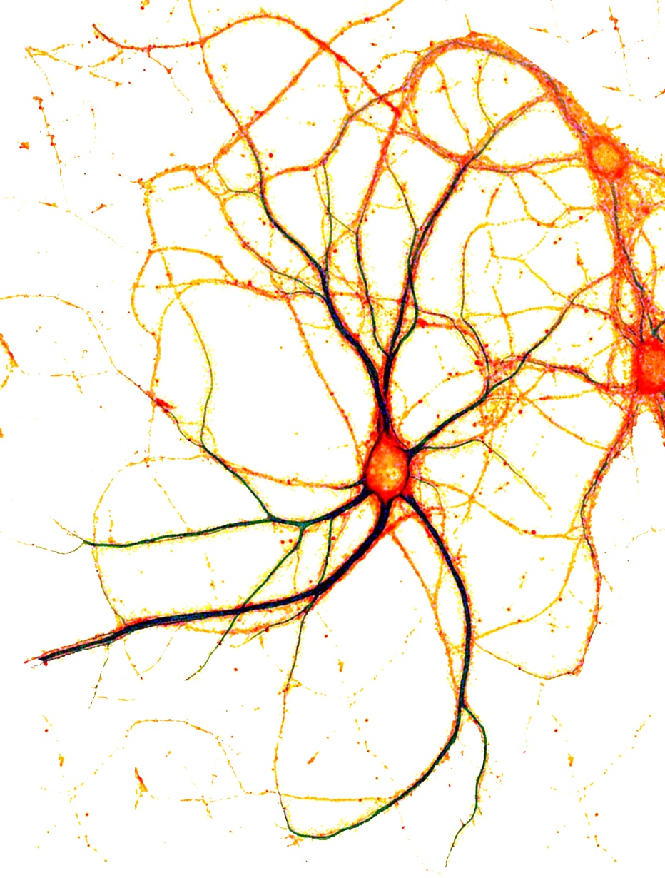

Everton Agnes, University of Oxford
Spiros Chavlis, Foundation for Research and Technology-Hellas
Nassi Papoutsi, Foundation for Research and Technology-Hellas
Bill Podlaski, University of Oxford & Champalimaud Center for the Unknown
Tutorial 5
Simulating dendrites at different levels of abstraction

Slide 2
Overview
Basics of compartmental modelling
Detailed modelling of dendrites
1.a. Introduction to NEURON
1.b. Passive dendritic integration
1.c. Active dendritic integration
3. Simplified models of dendrites
3.a. Introduction to BRIAN
3.b Adding dendrites to a LIF model
3c. Non-linear synapses
4. Role of dendrites in a working memory (network)
Morning session
Afternoon session

Slide 3
Installation steps
Download the code on GitHub: https://github.com/wpodlaski/ocns2019_simulatingdendrites
Install Anaconda 3 (Python 3)
Install NEURON

Slide 4
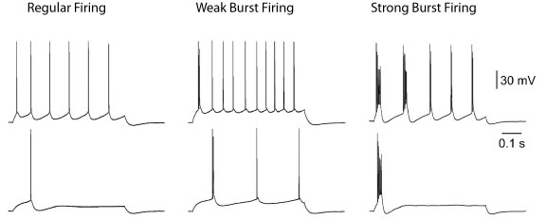
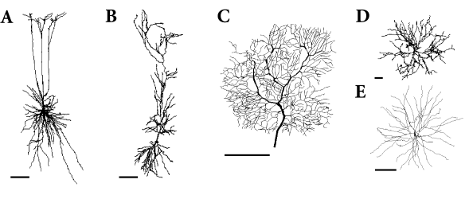
Neurons are (also) characterized by their dendritic tree
Neuron Types:
Classification using gene expression
Classification based on Excitatory or Inhibitory neurotransmission.
Classification using spiking activity
Classification by anatomical features
Williams, Stuart, J Physiol. 1999
http://NeuroMorpho.Org
Notes:
Reconstructed morphology of various types of neurons. A. Pyramidal neuron from a deep cortical layer. B. Pyramidal neuron from the CA1 of the hippocampus C. Purkinje cell from the cerebellum. D. Motoneuron from the spinal cord . E. Stellate neuron from the neocortex . Reconstructed morphologies can be downloaded from http://NeuroMorpho.Org. Scale bars represents 100 μm

Slide 5
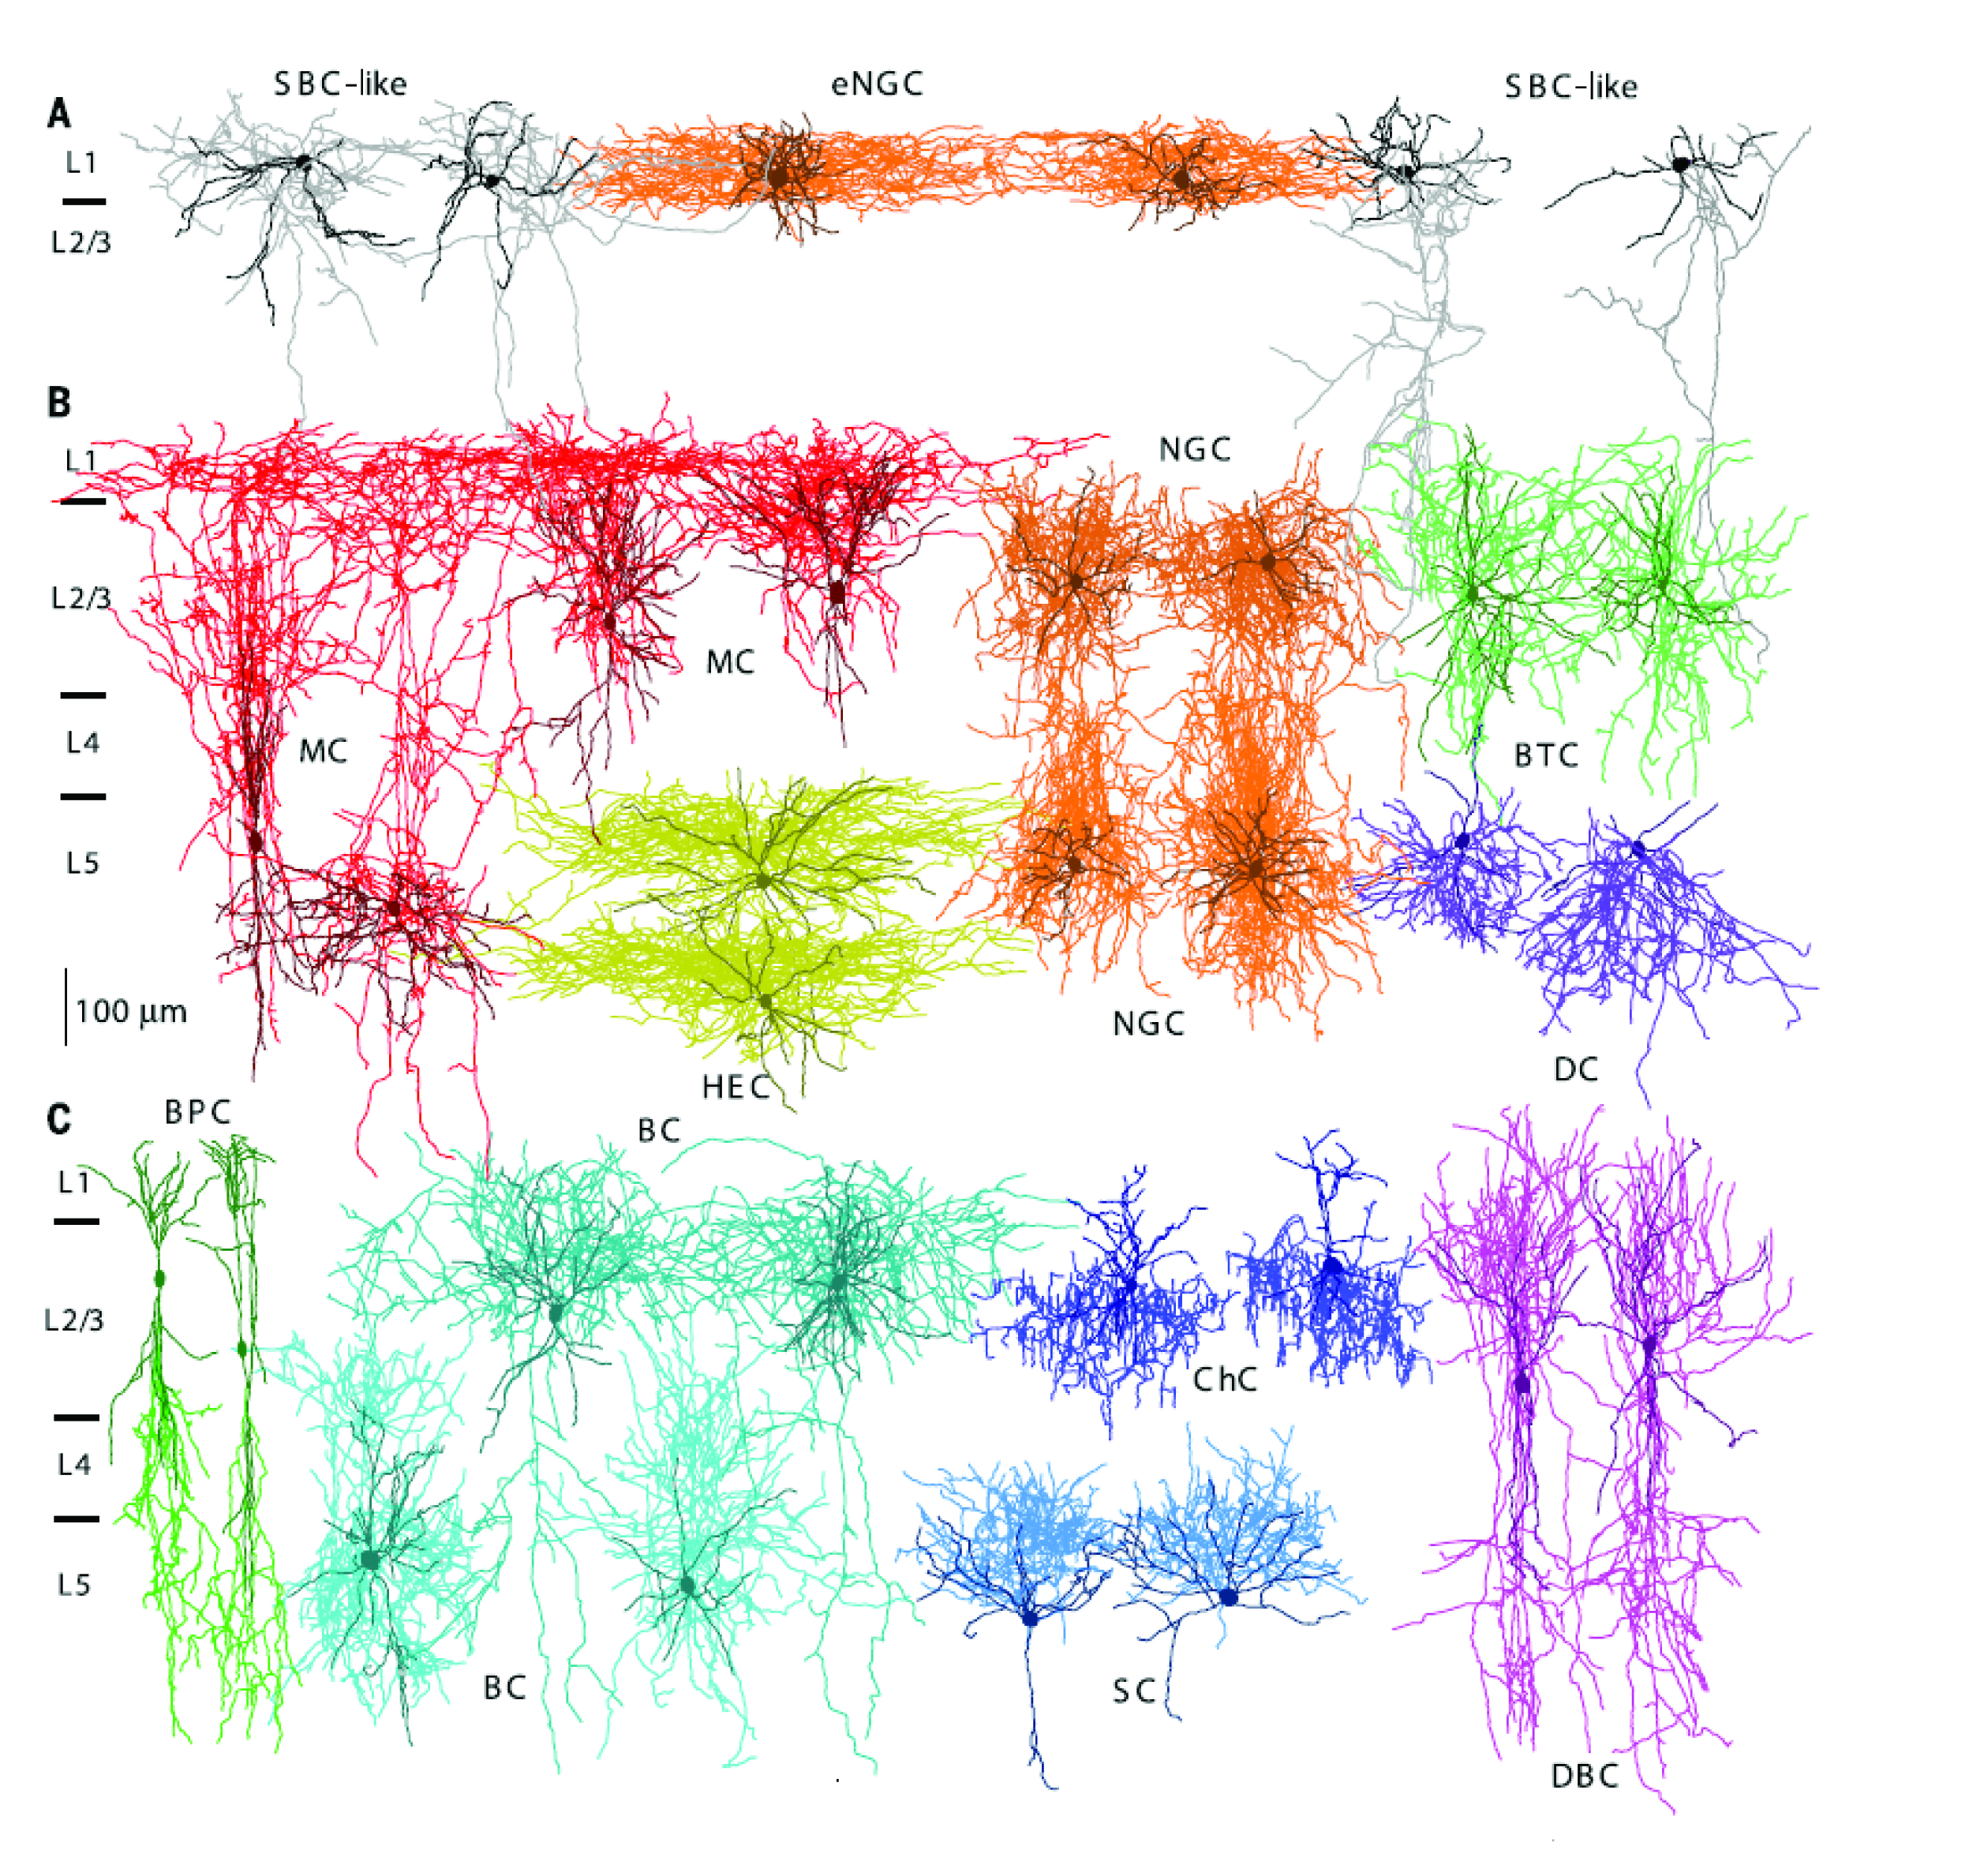
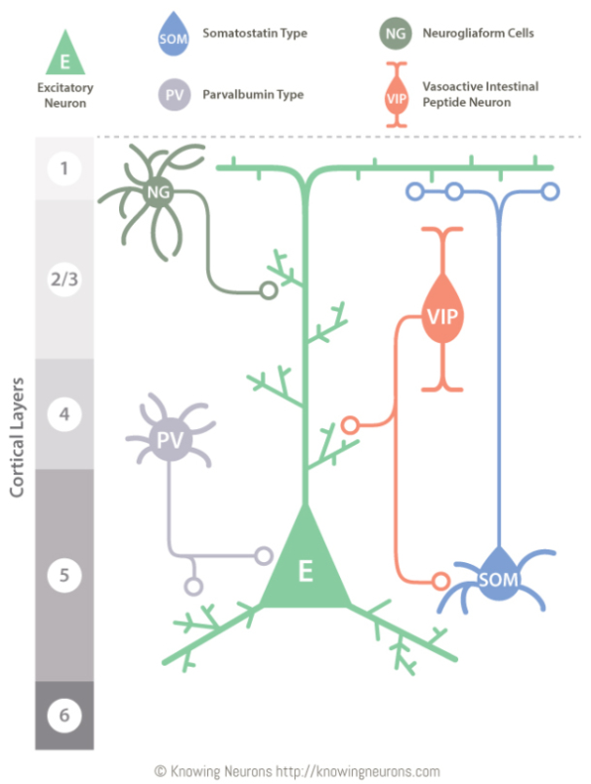
Neurons are (also) characterized by their neurotransmission
Large variability of interneuronal subtypes.
Jiang et al., Science 2015

Slide 6
What can dendrites do?
London & Hausser 2005 Ann Rev Neuro

Slide 7
Why model the details?
Interpretation of experimental results - Gain insights into key biophysical parameters.
Suggest possible computational (functional) role for the modeled system (predictions).
Inspire implementations in other fields.

Slide 8
Why abstract away the details?
Computational feasibility – simulate large networks / large number of parameter sweeps.
Analytical tractability-Comprehensive understanding of the underlying system.
Interpretability of results through the identification of key mechanisms in relation to a specific function.

Slide 9
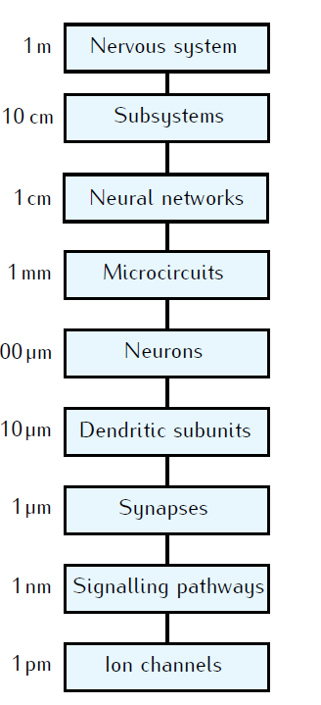
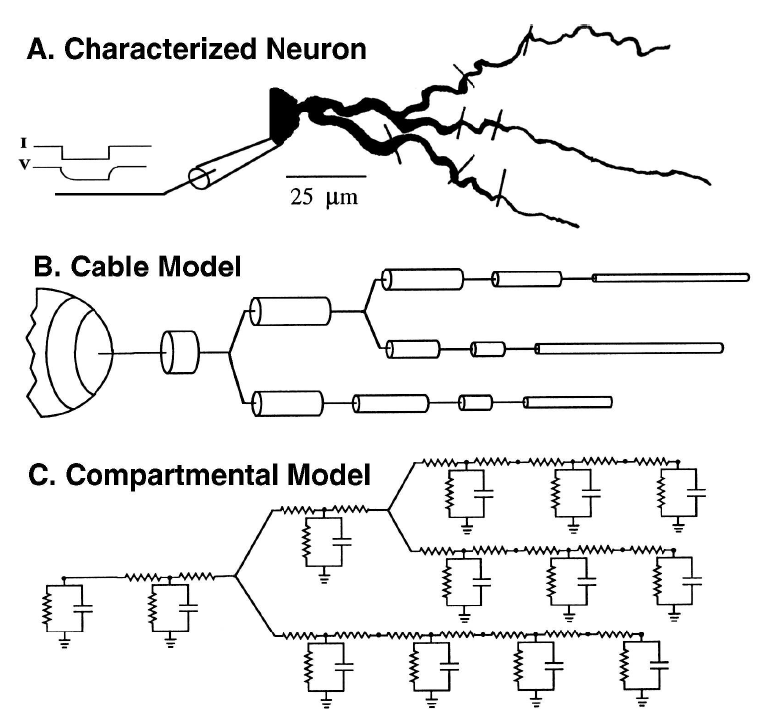
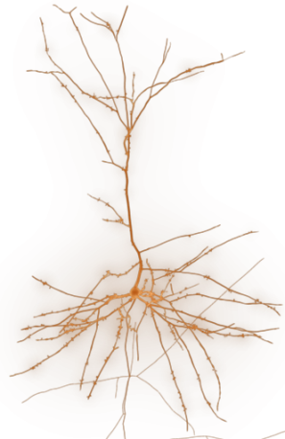
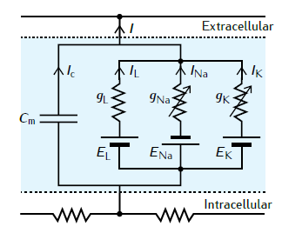
Modeling dendrites: Compartmental Modeling
Neuron
Compartment model

